Slide 1
Experimental Study: Measuring the Performance of Distributed Databases
Yugabyte vs Postgres with Citus
Duha Jarrar Hiba Naser
Nahil Idkadek Hana AL-Baidaq

Slide 2
Problem
The increasing need for scalable distributed database systems that provide high performance and low response times.

Slide 3
Objective
The research aims to evaluate the performance of distributed databases, focusing on PostgreSQL with the Citus extension and YugabyteDB, by measuring throughput and latency.
The problem lies in analyzing the impact of the number of workers and the increase in concurrent transactions on response time and throughput, facilitating an informed decision regarding the selection of the most suitable system for use in practical environments.

Slide 4
Related Work
Paper 1: Proxy-based Transaction Acceleration for NewSQL (2023) [13]
They presented a new approach using a central proxy to improve transaction processing in NewSQL databases.
Compared the performance between their approach and YugabyteDB.
They used Sysbench as a performance measurement tool.
Results: Performance improved by up to 8.25 times using new approach.
Paper 2: NewSQL Monitoring System (2021) [14]
Developed a monitoring system to track every node in NewSQL systems.
Compared the performance of YugabyteDB, Cassandra, and InfluxDB when storing monitoring data.
Budholia used Grafana and Prometheus tools to monitor the nodes.
He track metrics such as load, response time, and number of requests.
Results: Cassandra excelled in write performance, while YugabyteDB was the best for reads.

Slide 5
Related Work
Paper 3: An evaluation of relational and NoSQL distributed databases on a low-power cluster (2023) [15]
Compared Cassandra, HBase, and Citus/PostgreSQL.
They measured throughput, latency, performance under different workloads.
Used tools like Prometheus and YCSB to evaluate database performance in terms of throughput and response time.
Results: Cassandra performed best with the defined consistency levels.
Paper 4: OLAP performance of distributed PostgreSQL and MongoDB on OpenStack. Preliminary Results on Smaller Scale Factors (2024) [16]
Measured the performance of PostgreSQL and MongoDB to measure reliability.
Compared the performance of OLAP queries.
Results: Citus/PostgreSQL achieved greater success in query execution.

Slide 6
Research Questions
What is the impact of increasing the number of nodes (cluster size) on throughput in PostgreSQL with Citus versus YugabyteDB under OLTP workloads?
What is the impact of increasing the number of nodes (cluster size) on latency in PostgreSQL with Citus versus YugabyteDB under OLTP workloads?
How does raising the number of concurrent client loads (user requests) affect throughput in PostgreSQL with Citus and YugabyteDB?
How does raising the number of concurrent client loads (user requests) affect latency in PostgreSQL with Citus and YugabyteDB?

Slide 7
Hypothesis
Hypothesis of RQ1:
Null Hypothesis (H0): There is no significant difference in throughput between PostgreSQL with Citus and YugabyteDB as the number of worker nodes increases under OLTP workloads.
Alternative Hypothesis (H1): There is a significant difference in throughput between PostgreSQL with Citus and YugabyteDB as the number of worker nodes increases under OLTP workloads.
Hypothesis of RQ2:
Null Hypothesis (H0): There is no significant difference in latency between PostgreSQL with Citus and YugabyteDB as the number of worker nodes increases under OLTP workloads.
Alternative Hypothesis (H1): There is a significant difference in latency between PostgreSQL with Citus and YugabyteDB as the number of worker nodes increases under OLTP workloads.

Slide 8
Hypothesis
Hypothesis of RQ3:
Null Hypothesis (H0): There is no significant difference in throughput between PostgreSQL with Citus and YugabyteDB as the number of concurrent user requests increases in OLTP scenarios.
Alternative Hypothesis (H1): There is a significant difference in throughput between PostgreSQL with Citus and YugabyteDB as the number of concurrent user requests increases in OLTP scenarios.
Hypothesis of RQ4:
Null Hypothesis (H0): There is no significant difference in latency between PostgreSQL with Citus with YugabyteDB as the number of concurrent user requests increases in OLTP scenarios.
Alternative Hypothesis (H1): There is a significant difference in latency between PostgreSQL with Citus with YugabyteDB as the number of concurrent user requests increases in OLTP scenarios.

Slide 9
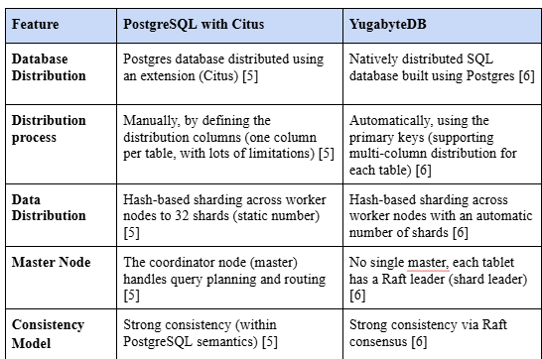
Architectures Overview

Slide 10
Experiment Design
To evaluate the 2 databases we started with:
Collect Dataset: we picked e-commarce database that includes 3 tables (customer, product, order).
Set distribution strategy: we used horizontal distribution strategy for big tables as customer table and order table and set the product table as reference table to achieve real world applications.
Select evaluation tool and workload.
Select the analysis tool.
Set Experiment variables:
Constant Variables
Hardware environment: All tests were conducted on the same host machine.
Schema and data volume: An Identical SQL schema and data size were used in all runs.
Transaction type and structure: A fixed workload script was used for all tests, including SELECT and INSERT transactions.
Benchmarking tool and configuration: The same version of pgbench with identical script logic was used throughout.
Container images and OS: Standardized Docker images were used for both database systems to ensure uniformity.
Dependent variables
Transaction Throughput (TPS): number of successful transactions per second
Transaction Latency (ms): average response time per transaction
Independent variables:
Number of worker nodes (cluster size): 3, 5, and 7.
Concurrent client load(client request): 1,000, 10,000, and 100,000 simulated clients.

Slide 11
Environment Setup
The experiments were conducted on a single physical host equipped with a 12th Gen Intel Core i7-1255U CPU (12 cores), 16 GB of RAM, and a 64-bit operating system.
All components of the experiment were deployed in isolated containers using Docker.
Note: All experiment steps were automated using Python and shell scripts that orchestrated cluster deployment, workload execution via pgbench, and result collection. This script ensured reproducibility, consistency, and reduced manual error across all test configurations. The full automation code is publicly available at [13].

Slide 12
Workload Simulation and Benchmarking
We used the pgbench tool to simulate OLTP transactions and measure system performance using the following custom workload to execute realistic operations (browsing products and placing orders):
SELECT * FROM product ORDER BY price ASC LIMIT 10;
INSERT INTO order_trans ()
SELECT nextval('order_id_seq'), :customer_id, :product_id, now() FROM product
WHERE product_id = :product_id;
Transactions were executed with prepared statements. We varied the number of concurrent client requests (from 1,000 to 100,000).

Slide 13
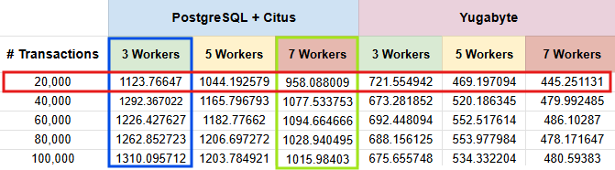
Experiment Execution
To assess the effect of worker nodes:
We fixed the number of client requests (e.g., at 10,000) and compared performance as the number of nodes increased from 3 to 5 to 7. This allowed us to isolate the impact of horizontal scaling on throughput and latency, without interference from changes in client load.
Throughput results example:

Slide 14
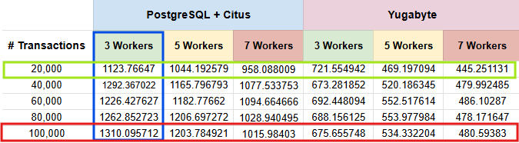
Experiment Execution
To assess the effect of the number of client requests:
We fixed the cluster size (e.g., 3 nodes) and varied the number of concurrent client connections from 1,000 to 100,000. This configuration allowed us to study how well each system handled increased transaction pressure independently of cluster size.
Throughput results example:

Slide 15
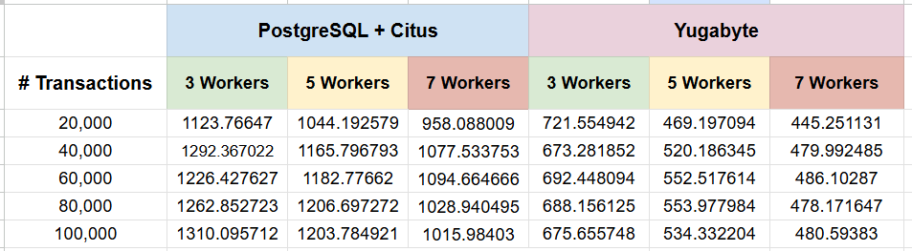
Experiment Execution
To compare database systems:
The same configurations were applied for both Citus and YugabyteDB, using identical data, workloads, and client loads. This direct pairing enabled meaningful performance comparisons between the two systems under the same experimental conditions.
Throughput results example:

Slide 16
Experiment Results: Throughput
Throughput (Transactions Per Second) result for Citus and YugabyteDB Under Varying Worker Counts and Transaction Volumes.

Slide 17
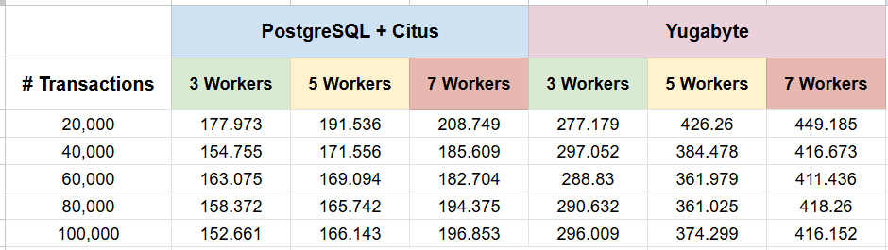
Experiment Results: Transaction Latency
Transaction Latency (ms) for Citus and YugabyteDB Under Varying Worker Counts and Transaction Volumes.

Slide 18
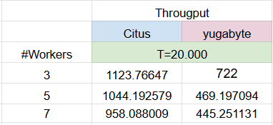
Data Analysis: Throughput vs. Number of Workers
RQ1: What impact does horizontal scaling (adding worker nodes) have on throughput in PostgreSQL with Citus versus YugabyteDB under OLTP workloads?
Table # 4. Average throughput for Citus and YugabyteDB Across Varying Worker Node Counts with 20,000 Transactions

Slide 19
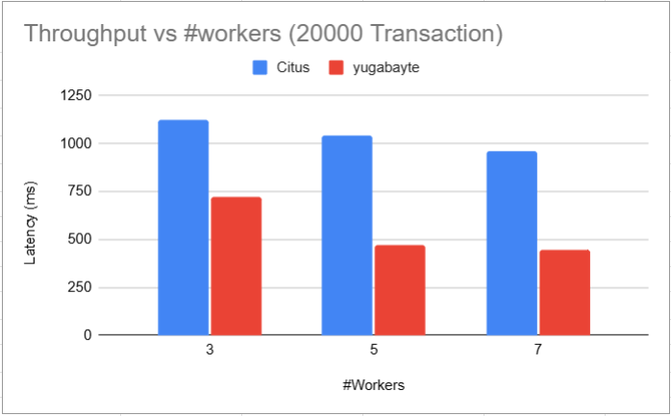
Data Analysis: Throughput vs. Number of Workers
Figure2 . Throughput for Citus and YugabyteDB Across Varying Worker Node Counts with 20,000 Transactions

Slide 20
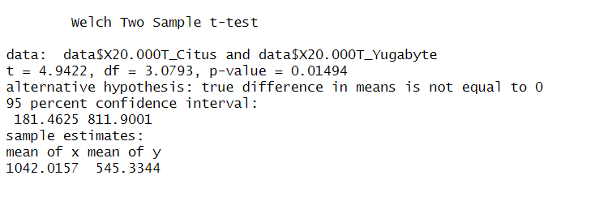
Data Analysis: Throughput vs. Number of Workers
Figure. Paired t-test Results Comparing Mean Throughput Between Citus and YugabyteDBv Across Varying Worker Counts

Slide 21
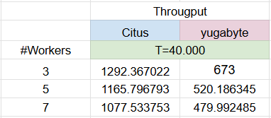
Data Analysis: Throughput vs. Number of Workers
RQ1: What impact does horizontal scaling (adding worker nodes) have on throughput in PostgreSQL with Citus versus YugabyteDB under OLTP workloads?
Table # 4. Average throughput for Citus and YugabyteDB Across Varying Worker Node Counts with 40,000 Transactions

Slide 22
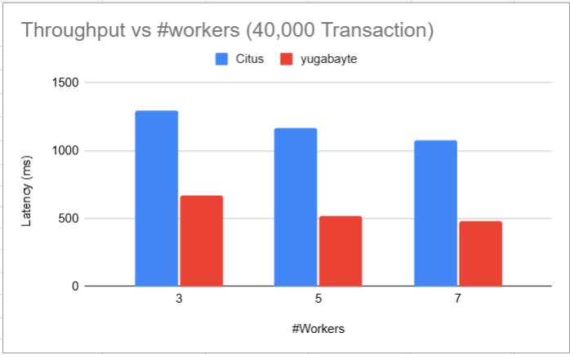
Data Analysis: Throughput vs. Number of Workers
Figure2 . Throughput for Citus and YugabyteDB Across Varying Worker Node Counts with 40,000 Transactions

Slide 23
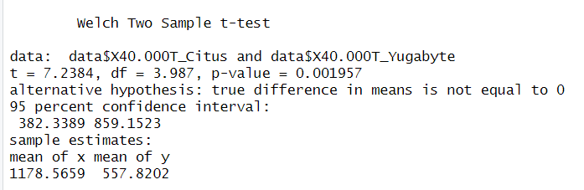
Data Analysis: Throughput vs. Number of Workers
Figure. Paired t-test Results Comparing Mean Throughput Between Citus and YugabyteDBv Across Varying Worker Counts

Slide 24
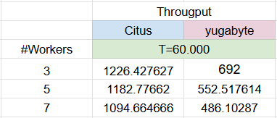
Data Analysis: Throughput vs. Number of Workers
RQ1: What impact does horizontal scaling (adding worker nodes) have on throughput in PostgreSQL with Citus versus YugabyteDB under OLTP workloads?
Table # 4. Average throughput for Citus and YugabyteDB Across Varying Worker Node Counts with 60,000 Transactions

Slide 25
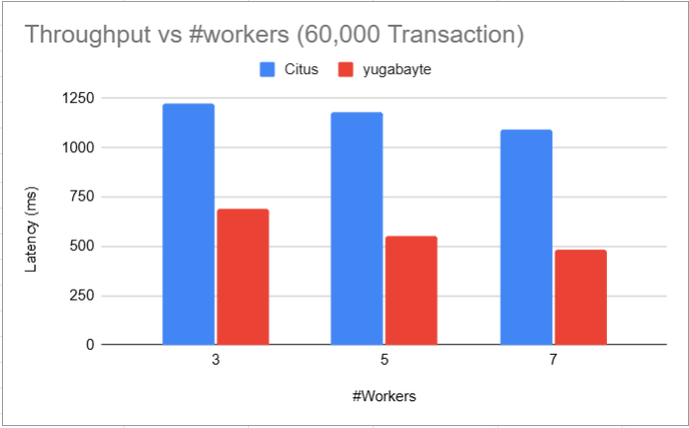
Data Analysis: Throughput vs. Number of Workers
Figure2 . Throughput for Citus and YugabyteDB Across Varying Worker Node Counts with 60,000 Transactions

Slide 26
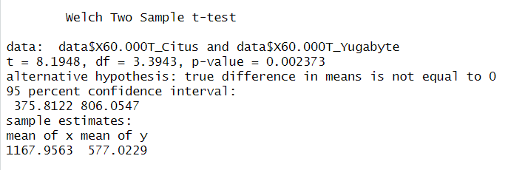
Data Analysis: Throughput vs. Number of Workers
Figure. Paired t-test Results Comparing Mean Throughput Between Citus and YugabyteDBv Across Varying Worker Counts

Slide 27
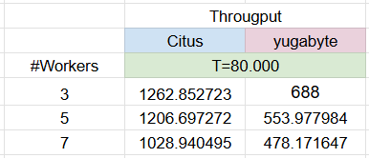
Data Analysis: Throughput vs. Number of Workers
RQ1: What impact does horizontal scaling (adding worker nodes) have on throughput in PostgreSQL with Citus versus YugabyteDB under OLTP workloads?
Table # 4. Average throughput for Citus and YugabyteDB Across Varying Worker Node Counts with 80,000 Transactions

Slide 28
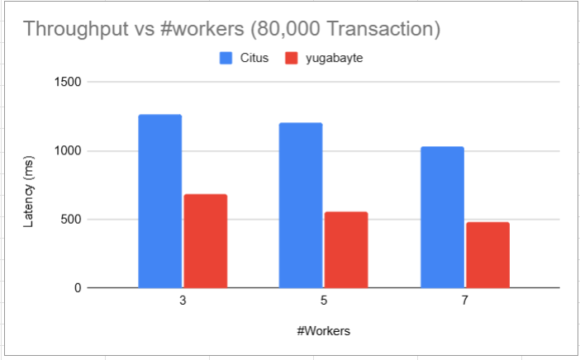
Data Analysis: Throughput vs. Number of Workers
Figure2 . Throughput for Citus and YugabyteDB Across Varying Worker Node Counts with 80,000 Transactions

Slide 29
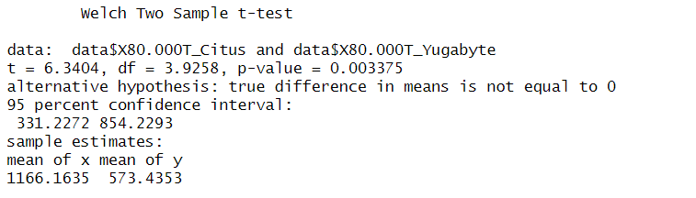
Data Analysis: Throughput vs. Number of Workers
Figure. Paired t-test Results Comparing Mean Throughput Between Citus and YugabyteDBv Across Varying Worker Counts

Slide 30
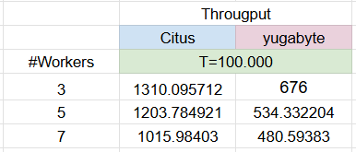
Data Analysis: Throughput vs. Number of Workers
RQ1: What impact does horizontal scaling (adding worker nodes) have on throughput in PostgreSQL with Citus versus YugabyteDB under OLTP workloads?
Table # 4. Average throughput for Citus and YugabyteDB Across Varying Worker Node Counts with 100,000 Transactions

Slide 31
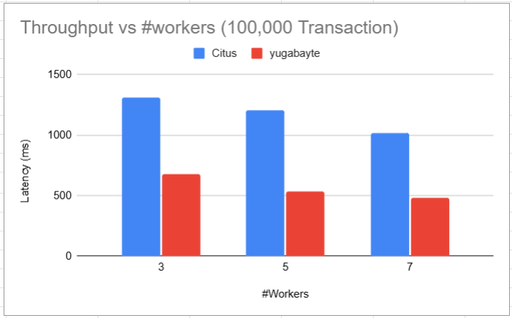
Data Analysis: Throughput vs. Number of Workers
Figure2 . Throughput for Citus and YugabyteDB Across Varying Worker Node Counts with 100,000 Transactions

Slide 32
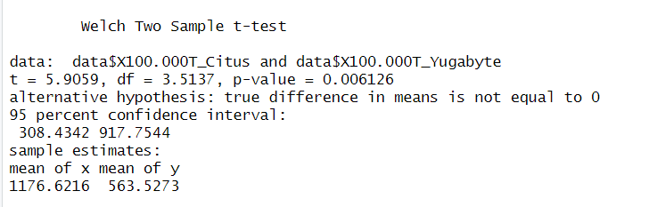
Data Analysis: Throughput vs. Number of Workers
Figure. Paired t-test Results Comparing Mean Throughput Between Citus and YugabyteDBv Across Varying Worker Counts

Slide 33
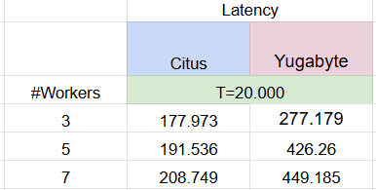
Data Analysis: Latency vs. Number of Workers
RQ2: What impact does horizontal scaling (adding worker nodes) have on latency in PostgreSQL with Citus versus YugabyteDB under OLTP workloads?
Table # 4. Average Latency (ms) for Citus and YugabyteDB Across Varying Worker Node Counts with 20,000 Transactions

Slide 34
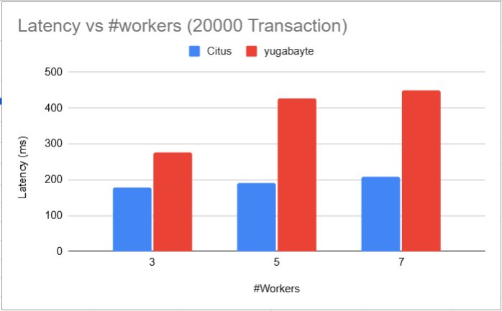
Data Analysis: Latency vs. Number of Workers
Figure2 . Latency (ms) for Citus and YugabyteDB Across Varying Worker Node Counts with 20,000 Transactions

Slide 35
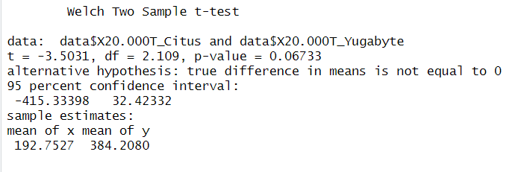
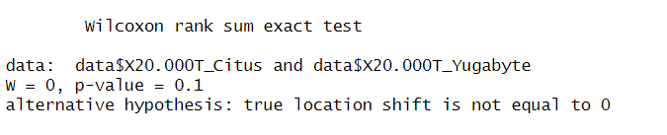
Data Analysis: Latency vs. Number of Workers
Figure. Paired t-test Results Comparing Mean Throughput Between Citus and YugabyteDBv Across Varying Worker Counts

Slide 36
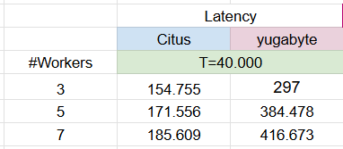
Data Analysis: Latency vs. Number of Workers
RQ2: What impact does horizontal scaling (adding worker nodes) have on latency in PostgreSQL with Citus versus YugabyteDB under OLTP workloads?
Table # 4. Average Latency (ms) for Citus and YugabyteDB Across Varying Worker Node Counts with 40,000 Transactions

Slide 37
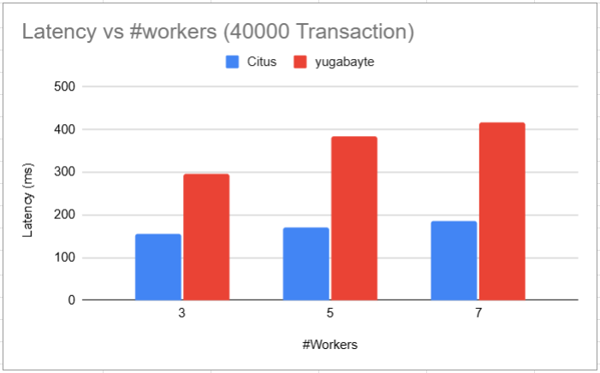
Data Analysis: Latency vs. Number of Workers
Figure2 . Latency (ms) for Citus and YugabyteDB Across Varying Worker Node Counts with 40,000 Transactions

Slide 38
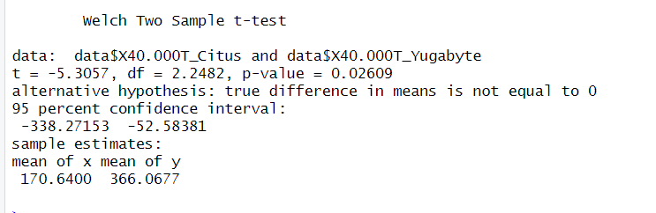
Data Analysis: Latency vs. Number of Workers
Figure. Paired t-test Results Comparing Mean Throughput Between Citus and YugabyteDBv Across Varying Worker Counts

Slide 39
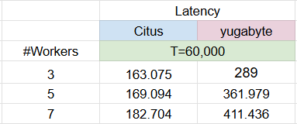
Data Analysis: Latency vs. Number of Workers
RQ2: What impact does horizontal scaling (adding worker nodes) have on latency in PostgreSQL with Citus versus YugabyteDB under OLTP workloads?
Table # 4. Average Latency (ms) for Citus and YugabyteDB Across Varying Worker Node Counts with 60,000 Transactions

Slide 40
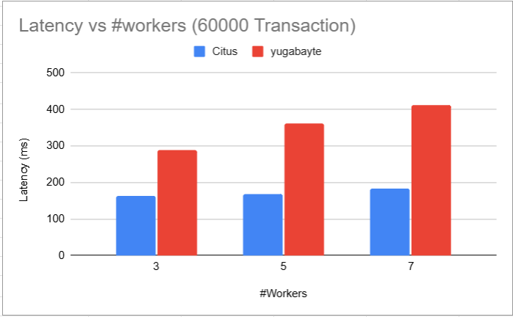
Data Analysis: Latency vs. Number of Workers
Figure2 . Latency (ms) for Citus and YugabyteDB Across Varying Worker Node Counts with 60,000 Transactions

Slide 41
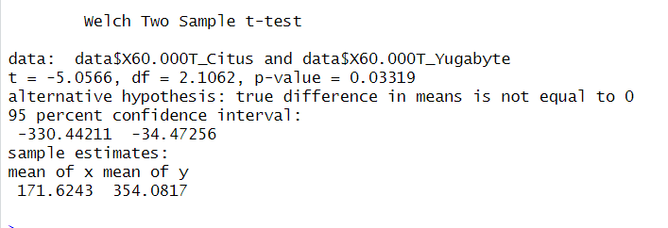
Data Analysis: Latency vs. Number of Workers
Figure. Paired t-test Results Comparing Mean Throughput Between Citus and YugabyteDBv Across Varying Worker Counts

Slide 42
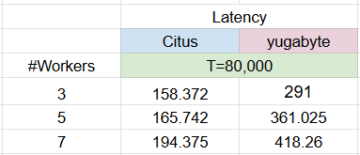
Data Analysis: Latency vs. Number of Workers
RQ2: What impact does horizontal scaling (adding worker nodes) have on latency in PostgreSQL with Citus versus YugabyteDB under OLTP workloads?
Table # 4. Average Latency (ms) for Citus and YugabyteDB Across Varying Worker Node Counts with 80,000 Transactions

Slide 43
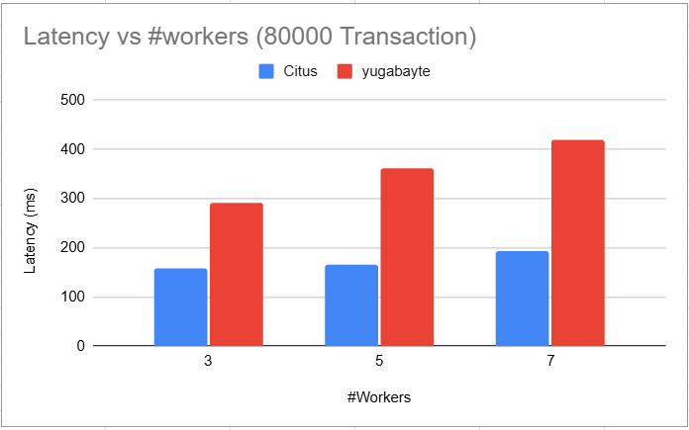
Data Analysis: Latency vs. Number of Workers
Figure2 . Latency (ms) for Citus and YugabyteDB Across Varying Worker Node Counts with 80,000 Transactions

Slide 44
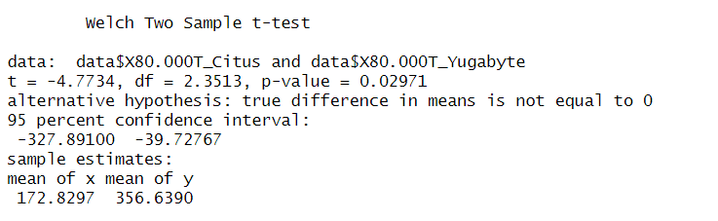
Data Analysis: Latency vs. Number of Workers
Figure. Paired t-test Results Comparing Mean Throughput Between Citus and YugabyteDBv Across Varying Worker Counts

Slide 45

Data Analysis: Latency vs. Number of Workers
RQ2: What impact does horizontal scaling (adding worker nodes) have on latency in PostgreSQL with Citus versus YugabyteDB under OLTP workloads?
Table # 4. Average Latency (ms) for Citus and YugabyteDB Across Varying Worker Node Counts with 100,000 Transactions

Slide 46

Data Analysis: Latency vs. Number of Workers
Figure2 . Latency (ms) for Citus and YugabyteDB Across Varying Worker Node Counts with 100,000 Transactions

Slide 47
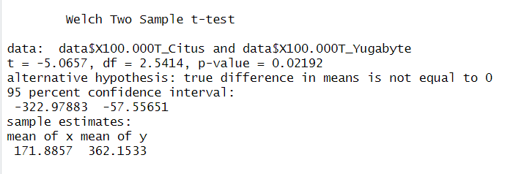
Data Analysis: Latency vs. Number of Workers
Figure. Paired t-test Results Comparing Mean Throughput Between Citus and YugabyteDBv Across Varying Worker Counts

Slide 48
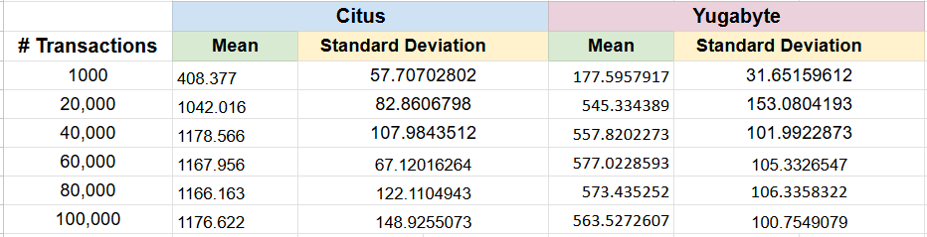
Data Analysis: Throughput vs. Number of Transactions
RQ3: How does increasing the number of concurrent user requests impact the throughput of PostgreSQL with Citus versus YugabyteDB in OLTP workloads?
Table. Mean Throughput (TPS) and Standard Deviation for Citus and YugabyteDB at Different
Transaction Load Levels

Slide 49
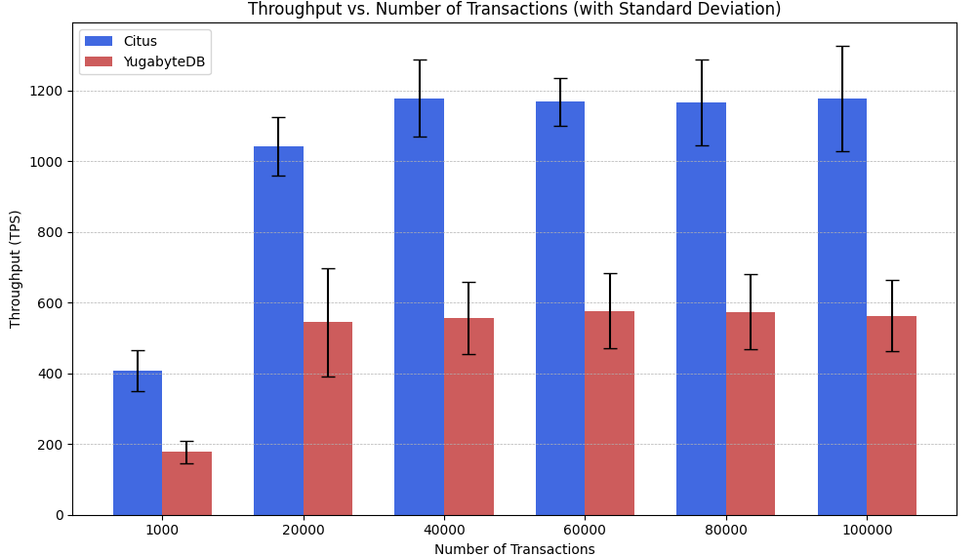
Data Analysis: Throughput vs. Number of Transactions
Figure. Mean Throughput with Standard Deviation for Citus and YugabyteDB Across Varying Transaction Load Levels

Slide 50
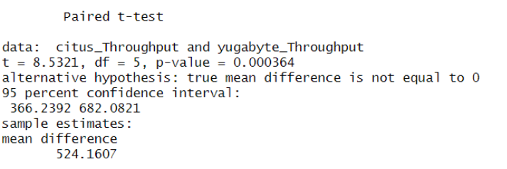
Data Analysis: Throughput vs. Number of Transactions
Figure. Paired t-test Results Comparing Mean Throughput Between Citus and YugabyteDB Across Varying Transaction Load Levels

Slide 51
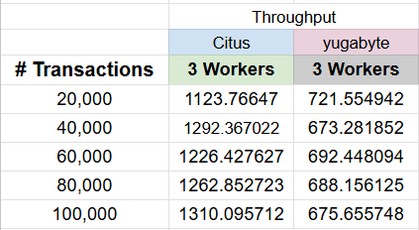
Data Analysis: Throughput vs. # of Transactions
RQ3: How does increasing the number of concurrent user requests impact the throughput of PostgreSQL with Citus versus YugabyteDB in OLTP workloads?
Table #3: Throughput (tps) for Citus and YugabyteDB with 3 Worker Nodes Across Increasing Transaction Volumes

Slide 52
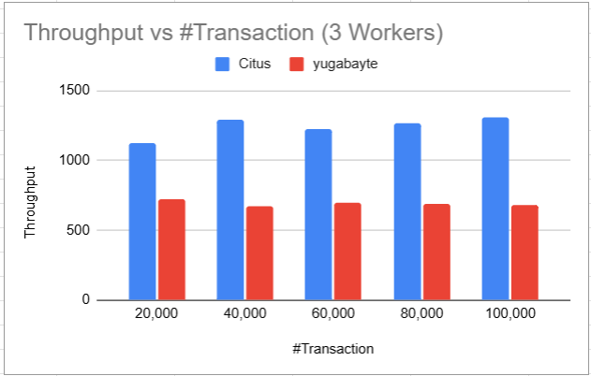
Data Analysis: Throughput vs. # of Transactions
Figure 1. Throughput (tps) for Citus and YugabyteDB with 3 Worker Nodes Across Increasing Transaction Volumes

Slide 53
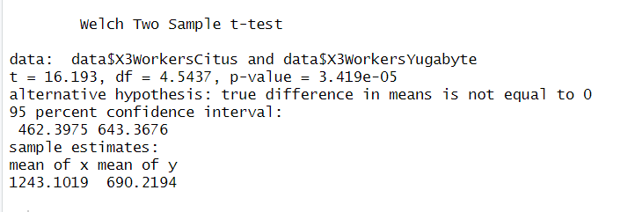
Data Analysis: Throughput vs. # of Transactions
Figure. Paired t-Test Results Comparing Throughput Between Citus and YugabyteDB with 3 Worker Nodes Across Increasing Transaction Volumes

Slide 54
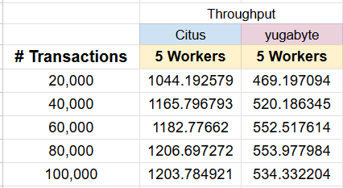
Data Analysis: Throughput vs. # of Transactions
RQ3: How does increasing the number of concurrent user requests impact the throughput of PostgreSQL with Citus versus YugabyteDB in OLTP workloads?
Table #3: Throughput (tps) for Citus and YugabyteDB with 5 Worker Nodes Across Increasing Transaction Volumes

Slide 55
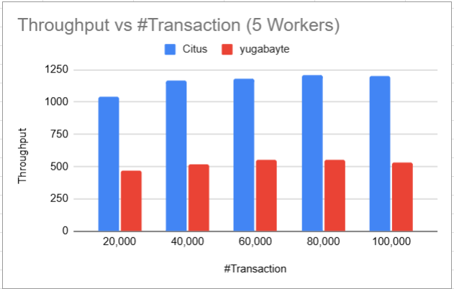
Data Analysis: Throughput vs. # of Transactions
Figure 1. Throughput (tps) for Citus and YugabyteDB with 5 Worker Nodes Across Increasing Transaction Volumes

Slide 56
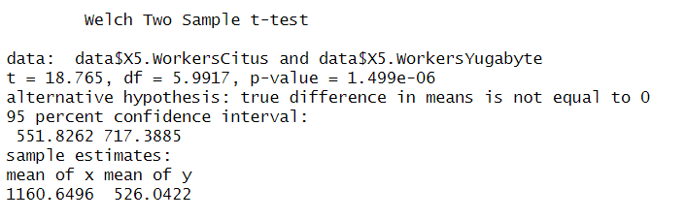
Data Analysis: Throughput vs. # of Transactions
Figure. Paired t-Test Results Comparing Throughput Between Citus and YugabyteDB with 5 Worker Nodes Across Increasing Transaction Volumes

Slide 57
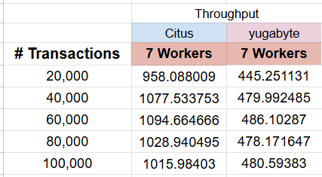
Data Analysis: Throughput vs. # of Transactions
RQ3: How does increasing the number of concurrent user requests impact the throughput of PostgreSQL with Citus versus YugabyteDB in OLTP workloads?
Table #3: Throughput (tps) for Citus and YugabyteDB with 7 Worker Nodes Across Increasing Transaction Volumes

Slide 58
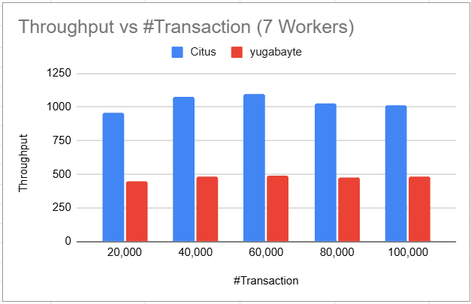
Data Analysis: Throughput vs. # of Transactions
Figure 1. Throughput (tps) for Citus and YugabyteDB with 7 Worker Nodes Across Increasing Transaction Volumes

Slide 59
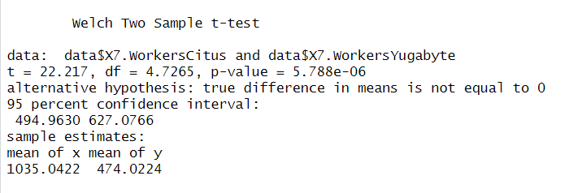
Data Analysis: Throughput vs. # of Transactions
Figure. Paired t-Test Results Comparing Throughput Between Citus and YugabyteDB with 7 Worker Nodes Across Increasing Transaction Volumes

Slide 60
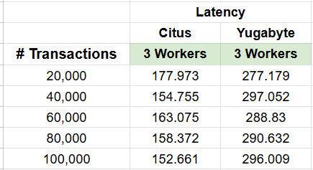
Data Analysis: Latency vs. Number of Transactions
RQ4: How does increasing the number of concurrent user requests impact the latency of PostgreSQL with Citus versus YugabyteDB in OLTP workloads?
Table. latency (ms) for Citus and YugabyteDB with 3 Worker Nodes Across Increasing Transaction Volumes

Slide 61
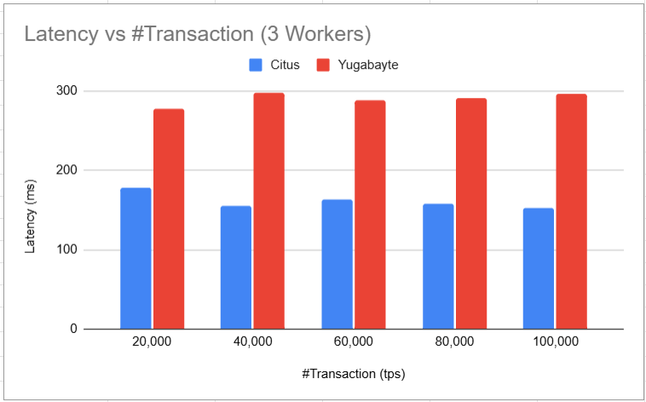
Data Analysis: Latency vs. Number of Transactions
Figure. latency (ms) for Citus and YugabyteDB with 3 Worker Nodes Across Increasing Transaction Volumes

Slide 62
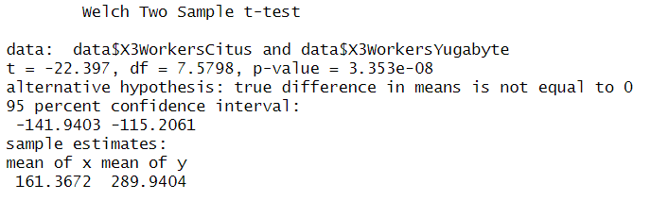
Data Analysis: Latency vs. Number of Transactions
Figure. Paired t-Test Comparing Latency of Citus and YugabyteDB with 3 Worker Nodes

Slide 63
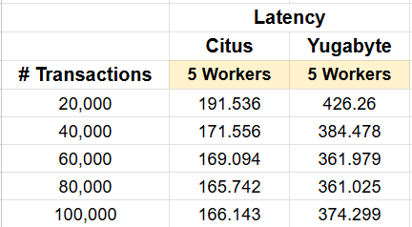
Data Analysis: Latency vs. Number of Transactions
RQ4: How does increasing the number of concurrent user requests impact the latency of PostgreSQL with Citus versus YugabyteDB in OLTP workloads?
Table. latency (ms) for Citus and YugabyteDB with 5 Worker Nodes Across Increasing Transaction Volumes

Slide 64

Data Analysis: Latency vs. Number of Transactions
Figure. latency (ms) for Citus and YugabyteDB with 5 Worker Nodes Across Increasing Transaction Volumes

Slide 65

Data Analysis: Latency vs. Number of Transactions
Figure. Paired t-Test Comparing Latency of Citus and YugabyteDB with 5 Worker Nodes

Slide 66

Data Analysis: Latency vs. Number of Transactions
RQ4: How does increasing the number of concurrent user requests impact the latency of PostgreSQL with Citus versus YugabyteDB in OLTP workloads?
Table. latency (ms) for Citus and YugabyteDB with 7 Worker Nodes Across Increasing Transaction Volumes

Slide 67

Data Analysis: Latency vs. Number of Transactions
Figure. latency (ms) for Citus and YugabyteDB with 7 Worker Nodes Across Increasing Transaction Volumes

Slide 68

Data Analysis: Latency vs. Number of Transactions
Figure. Paired t-Test Comparing Latency of Citus and YugabyteDB with 3 Worker Nodes

Slide 69
Discussion
The results showed that Citus benefits more from horizontal scaling, achieving higher throughput and lower response times compared to YugabyteDB.
As the loads increased, Citus maintained productivity gains with stable variance, whereas YugabyteDB reached an early period of little changed (plateau) and showed larger standard deviations, indicating less predictable performance under high loads.
The latency analysis showed that Citus was below 200 milliseconds under most loads, while YugabyteDB exceeded 350 milliseconds.
Statistical tests using the t-test confirm the performance differences, allowing us to reject the null hypothesis.
Notes:
Raft is a leader-based consensus algorithm designed to manage a replicated log across a cluster of servers, ensuring that all nodes agree on the same sequence of state-machine commands.

Slide 70
Discussion
The architectural interpretation reveals fundamental differences in the distributed designs of Citus and YugabyteDB:
Citus’s coordinator-worker model centralizes query planning in a single node, enhancing throughput and reducing latency while avoiding multi-round consensus overhead. In contrast, YugabyteDB employs Raft-based replication, ensuring strong consistency but suffering from higher latency due to commit path delays as cluster size increases.
For applications requiring high transactional throughput, such as online store fronts, PostgreSQL with Citus is advantageous, particularly in single data center deployments. Conversely, organizations needing geo-distributed availability with strong consistency may prefer YugabyteDB for its automatic failover and multi-region replication.

Slide 71
Threats
Threats to Internal Validity
Simulated Environment: May not capture all real-world cases that could affect database performance.
Complexity of Operations: Focuses only on basic operations such as Select and Insert queries. More complex queries or transactions involving joins may yield different results.
Data Bias: Data from a specific system (e-commerce system) is used, and the results cannot be generalized to all systems.
Data Size: The small data size, reaching up to 150,000, may lead to different results compared to larger datasets.

Slide 72
2) Threats to External Validity
Single-host deployment: Running all containers on one physical machine removes network variability but also limits our ability to evaluate inter-data-center latencies and real network partitions.
Distributed method: Yugabyte relies on distributing data based on the primary key, which can consist of more than one column. In contrast, in PostgreSQL, the primary key is chosen by us, allowing us to select the optimal column for data distribution accordingly.

Slide 73
3) Threats to Construct Validity
Simplified schema: We used a three-table e-commerce model, may lead to different results compared to larger schema.
Resource isolation: Although Docker cgroups limited noisy-neighbor effects, containerization overhead and host-level contention may differ from bare-metal or VM-based deployments.

Slide 74
Future Work
Building on our findings, we recommend exploring:
Multi-host and geo-distributed clusters to evaluate network partition tolerance and cross-region performance,
Workloads with complex transactions like multi-shard joins, and analytical queries to see how each system balances OLTP and OLAP demands.
Failure injection experiments as node failures and network partitions to compare recovery time and data availability,
Adaptive sharding strategies in Citus, such as co-location and resharding, and Raft-tuning in YugabyteDB, like dynamic quorum reconfiguration to further optimize performance under varying load patterns.

Slide 75
Conclusion
Goal: Compare PostgreSQL + Citus vs. YugabyteDB on ecommerce-style OLTP, measuring TPS and latency.
Setup: Containers with 3, 5, 7 workers; 1,000–100,000 concurrent transactions; identical schema, data, scripts.
Throughput: Citus achieves 1.8–2× the TPS of YugabyteDB; scaling from 3→7 nodes drops Citus TPS ≈ 22% vs. YugabyteDB ≈ 38%.
Latency: Citus avg 150–254 ms vs. YugabyteDB 398–556 ms; Citus shows tight tail variability as nodes increase.
Significance: Paired t-tests (p < 0.05) confirm all performance gaps are statistically significant.
Architecture trade-offs: Citus’s lightweight coordinator–worker commits favor raw performance; YugabyteDB’s Raft consensus offers stronger distribution at higher latency cost.
Recommendations: Use PostgreSQL + Citus for high-throughput, low-latency OLTP in single-region deployments; choose YugabyteDB for geo-distributed, fault-tolerant scenarios.
Next steps: Evaluate multi-host/geodistributed topologies, multi-shard and analytical queries, failure-injection, and adaptive sharding/quorum strategies.

Slide 76
References
[1] Xu, Q., Yang, C., & Zhou, A. (2024). Native Distributed Databases: Problems, Challenges and Opportunities. Proceedings of the VLDB Endowment, 17(12), 4217-4220.
[2] Yugabyte. (n.d.). PostgreSQL. https://www.yugabyte.com/postgresql/
[3] Crunchy Data. (2021). An overview of distributed PostgreSQL architectures. https://www.crunchydata.com/blog/an-overview-of-distributed postgresql-architectures
[4] Cubukcu, U., Erdogan, O., Pathak, S., Sannakkayala, S., & Slot, M. (2021, June). Citus: Distributed postgresql for data-intensive applica tions. In Proceedings of the 2021 International Conference on Manage ment of Data (pp. 2490-2502).
[5] Citus Documentation- Citus 13.0.1 documentation. (n.d.). Retrieved June 30, 2025, from https://docs.citusdata.com/

Slide 77
[6] YB Documentation. (n.d.-b). YugabyteDB Docs. Retrieved June 30, 2025, from https://docs.yugabyte.com/
[7] Mihalcea, V. (2020). YugabyteDB https://vladmihalcea.com/yugabytedb-architecture/ architecture.
[8] Liu, Y., & Chen, L. (2019). A scalable and efficient architecture for distributed SQL databases. ACM Transactions on Database Systems, 44(3), 1-34. https://doi.org/10.1145/3448016.3457551
[9] Docker. (n.d.). What is a container? Retrieved June 14, 2025, from https://www.docker.com/resources/what-container/
[10] Watanabe, Y., Kawashima, R., & Matsuo, H. (2023, November). Proxy based Transaction Acceleration for NewSQL. In 2023 Eleventh Inter national Symposium on Computing and Networking Workshops (CAN DARW) (pp. 343-347). IEEE.
[11] Budholia, A. (2021). NewSQL Monitoring System.
[12] Salunke, S. V., & Ouda, A. (2024). A Performance Benchmark for the PostgreSQL and MySQL Databases. Future Internet, 16(10), 382.

Slide 78
[13] Watanabe, Y., Kawashima, R., & Matsuo, H. (2023, November). Proxy based Transaction Acceleration for NewSQL. In 2023 Eleventh Inter national Symposium on Computing and Networking Workshops (CAN DARW) (pp. 343-347). IEEE.
[14] Budholia, A. (2021). NewSQL Monitoring System.
[15] Da Silva, L. F., & Lima, J. V. (2023). An evaluation of relational and NoSQL distributed databases on a low-power cluster. The Journal of Supercomputing, 79(12), 13402-13420.
[16] Fotache, M., Badea, C., Cluci, M. I., Pˆ ınzaru, C., Es ¸anu, C. S., & Rusu, O. (2024, September). OLAP performance of distributed PostgreSQL and MongoDB on OpenStack. Preliminary Results on Smaller Scale Factors. In 2024 23rd RoEduNet Conference: Networking in Education and Research (RoEduNet) (pp. 1-6). IEEE.
[17] Jarrar, D. (2025). Distributed Database Citus vs Yugabyte Automation Benchmarking Scripts [Source code]. GitHub. Retrieved June 30, 2025, from https://github.com/duhajarrar/distributed database citus yugabyte
[18] Giceva, J., Sadoghi, M. (2018). Hybrid OLTP and OLAP. In: Sakr, S., Zomaya, A. (eds) Encyclopedia of Big Data Technologie

